Slide 1
Technical Support (420-1N6-AB) Data Representation
Fall 2022
Adapted for Fall 2024

Slide 2
Outline
Binary System
Representing Numbers in Binary
Representing Negative Numbers in Binary
Representing Text in Binary
Hexadecimal Numbers
Boolean Logic & Logical Gates
Binary Math

Slide 3
The Binary System
Everyone “knows” that computers use “binary” to operate
But, as we saw last class, computers don’t “know” anything -- ultimately, its CPU is just configured to react in particularly sophisticated ways when its switches (the lightbulbs) are turned on or off
So what is binary anyway? And what does it have to do with computers?
In order to understand the Binary numeral system, we can compare it to something we already know: the Decimal numeral system.

Slide 4
The Binary System
In decimal, numbers are represented by combinations of ten different symbols: (0, 1, 2, 3, 4, 5, 6, 7, 8, 9). We call decimal a base 10 numeral system.
If we have more than “9” of something, another digit is needed:
9 + 1 = 10
99 + 1 = 100, etc.
How do we represent numbers in binary?

Slide 5
The Binary System
In binary, there are only two symbols (0, 1). We call binary a base 2 numeral system.
So if we have more than “1” of something, another bit is needed:
1 + 1 = 10 (in english: one plus one equals two)
11 + 1 = 100 (in english: three plus one equals four)
It’s counterintuitive at first! But there’s nothing fundamentally different about binary than decimal -- we’re just more used to using decimal instead.

Slide 6
The Binary System
Since we’re reusing symbols from the decimal system, there is a convention to use subscript to disambiguate between different numeral systems
1₂ + 1₂ = 10₂ is the same as 1₁₀ + 1₁₀ = 2₁₀ is the same as one plus one equals two
11₂ + 1₂ = 100₂ is the same as 3₁₀ + 1₁₀ = 4₁₀ is the same as three plus one equals four
This is not always required, but can be useful when the numeral systems are mixed in the same context.

Slide 7
The Binary System
Note: binary and decimal are not the only possible numeral systems. All that distinguishes numeral systems is the number of symbols you agree to use to represent numbers -- there are infinite possible numeral systems!
Hexadecimal is another useful numeral system (16 symbols, or base 16) which we will discuss later

Slide 8
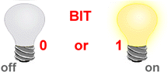
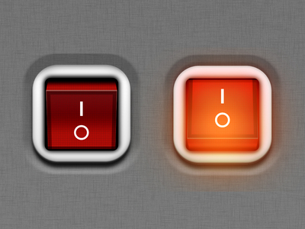
BIT – BInary digiT
So what does Binary have to do with computers?
Bit (Binary Digit) is the basic unit of information representing one of two discrete states.
The smallest unit of information within the computer.
Bit has one of two values:
0 (off) or 1 (on)
0 (False) or 1 (True)

Slide 9
How are Bits Represented in a Computer?
A transistor that is switched on or off
A capacitor that is charged or discharged.
On magnetic disks bits are represented by direction of the magnetic field (N-S, S-N).
Optical discs store bits optically (a bit on the surface is either shiny or not shiny).
Data is transmitted over telephone line or radio link using high- and low-pitched tones.
0
1
1
0
1
0
0
0
1
0
1
1
0
1
0
1

Slide 10
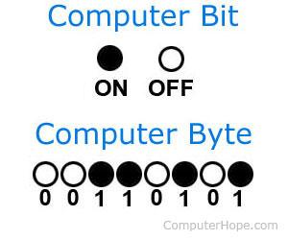
Byte
A Byte is a collection of bits known as the unit of digital information.
1 Byte = 8 bits
Abbreviation: B

Slide 11
Byte History
The byte represents the number of bits used to encode one character in a computer and hence it is the smallest addressable unit of memory in several computer architectures.
Size of a byte has been hardware dependent and no definitive standards existed that mandated the size.
A standard was introduced in 1993 that is common now.
1 byte = 8 bits

Slide 12
SI Prefixes: Scale
1 byte (B)
Kilobyte (KB) = 1,000 bytes
“one thousand bytes”
Megabyte (MB) = 1,000,000 bytes
“one million bytes”
Gigabyte (GB) = 1,000,000,000 bytes
“one billion bytes”
Terabyte (TB) = 1,000,000,000,000
“one trillion bytes”
https://www.nist.gov/pml/owm/metric-si-prefixes

Slide 13
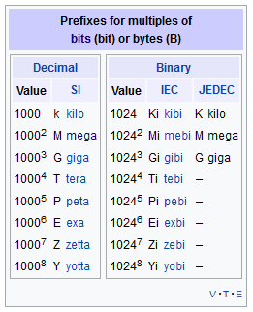
Non SI-Prefixes: Powers of 2
1 byte (B)
Kibibyte (KiB) = 1,024 bytes (2¹⁰) = 1.024KB
1,024 = 2 * 2 * 2 * 2 * 2 * 2 * 2 * 2 * 2 * 2
Mebibyte (MiB) = 1,048,576 bytes (2²⁰) = 1.048 MB
Gibibyte (GiB) = 1,073,741,824 bytes (2³⁰) = 1.073 GB
Tebibyte (TiB) = 1,099,511,627,776 bytes (2⁴⁰) = 1.1 TB
https://en.wikipedia.org/wiki/Byteb
Note: the difference between SI and Non-SI systems start small, but grow in significance at larger sizes of storage. See https://superuser.com/a/433216 for a thorough explanation

Slide 14
Representing Numbers in Binary

Slide 15
Converting Binary to Decimal
Converting binary to decimal is easy to memorize for small numbers. For example:
Binary | Decimal
0 | 0
1 | 1
10 | 2
11 | 3
100 | 4
101 | 5
110 | 6

Slide 16
Converting Binary to Decimal
What about larger numbers? How can we approach this problem systematically, i.e., use a defined method to confidently get the correct answer every time?
Binary | Decimal
1001
1101101
1000001
1111111
100000011000001

Slide 17
Converting Binary to Decimal
Well, how do we do it for decimals? A large number, like 2608, is in fact the combination of multiples of powers of ten. When we say these numbers in English, we naturally decompose the number into its component parts:
2608 is two thousand, six hundred, and eight.
Or, in other words:
2608 = 2 x 10³ + 6x10² + 0x10¹ + 8x10⁰
We can use this exact method, with one key difference, to decompose the value of binary numbers just like decimal numbers.
What key difference? (powers of 2 instead of powers of 10)

Slide 18
Converting: Binary to Decimal
Find the power of 2 value for each bit of the binary number, starting from 0. (e.g., the power of 2 value for the 5th bit of a binary number is: 2⁵=32, etc.)
Add all the powers of two wherever there is a 1 in the bit of the binary number
The sum of the powers of two above is the value of the binary number in decimal!
Binary Number | 1 | 1 | 0 | 0 | 1
Step 1 | 4 | 3 | 2 | 1 | 0
Step 2 | 2⁴ | 2³ | 2² | 2¹ | 2⁰
 | 16 | 8 | 4 | 2 | 1
Step 3 | 16 + 8 + 1 = 25

Slide 19
Exercise: Converting Binary to Decimal
Convert the following binary numbers to decimal:
1001
1101101
1000001
1111111
100000011000001

Slide 20
Converting Decimal Number to Binary
Going the other way (from Decimal to Binary) is a bit less natural -- we cannot “see” directly from the decimal representation of a number (like 2608, for instance), how many powers of two are needed to make the equivalent number in binary.
Instead, we’ll learn an algorithm (a series of deterministic steps to solve an analytical problem)
Convert Decimal to Binary by Repeated Division
Divide the decimal number by 2 using long division.
Note down the outcome and remainder of the division on the side.
Repeat steps 1 and 2 on the outcome until the outcome becomes zero.
The binary number will be the series of the remainders, read from bottom to top.

Slide 21
Demo: Converting Decimal Number to Binary
Covert 25 to binary.
Long Division (divide the Outcome by 2 at every step):
Outcome | Remainder
25

Slide 22
Demo: Converting Decimal Number to Binary
25/2 = 12.5. or 12 remainder 1.
Outcome | Remainder
25 | 1
12

Slide 23
Demo: Converting Decimal Number to Binary
2) 12/2 = 6, no remainder
Outcome | Remainder
25 | 1
12 | 0
6

Slide 24
Demo: Converting Decimal Number to Binary
3) 6/2 = 3, no remainder
Outcome | Remainder
25 | 1
12 | 0
6 | 0
3

Slide 25
Demo: Converting Decimal Number to Binary
4) 3/2 = 1.5, or 1 remainder 1
Outcome | Remainder
25 | 1
12 | 0
6 | 0
3 | 1
1

Slide 26
Demo: Converting Decimal Number to Binary
5) 1/2 = 0.5, or 0 remainder 1
Outcome | Remainder
25 | 1
12 | 0
6 | 0
3 | 1
1 | 1
0

Slide 27
Demo: Converting Decimal Number to Binary
Covert 25 to binary.
Outcome | Remainder
25 | 1
12 | 0
6 | 0
3 | 1
1 | 1
0
(25)₁₀ = (11001)₂

Slide 28
Exercise: Converting Decimal Number to Binary
Convert 107 to binary.
Outcome | Remainer
107
double check you have the correct answer! google “107 in binary”

Slide 29
Practise: Converting Decimal to Binary
Convert the following into binary. Show your work.
10
64
128
146
300

Slide 30
How many Numbers can I represent?
1 bit -> can represent 2 numbers
(0)₂ = (0)₁₀
(1)₂ = (1)₁₀
2 bits -> can represent 4 numbers
(00)₂ = (0)₁₀
(01)₂ = (1)₁₀
(10)₂ = (2)₁₀
(11)₂ = (3)₁₀
Values: 0 to 3 in decimal.

Slide 31
n Bits ⬄ How many Numbers
Possible Test Question
How many numbers can I represent in 4 bytes? What is the first and last number?
n bits
-> Can represent 2^{n} numbers
-> Values: from 0 to (2^{n} -1)
1 Byte -> 8 bit -> 2⁸ numbers (256)
First Number 0000 0000₂ = 0₁₀
Last Number 1111 1111₂ = 2⁸-1 = 255₁₀
2 Byte -> 16 bit -> 2¹⁶ numbers (65536)
First Number 0000 0000 0000 0000₂ = 0₁₀ to
Last Number 1111 1111 1111 1111₂ = 2¹⁶-1 = 65535₁₀

Slide 32
Representing Text

Slide 33
Text in Computers
In early years, different computer companies applied the binary system in their own way.
The word “cat” would be encoded in binary different on different brands of computers.
This made life difficult in terms of being able to transfer data from one system to another.

Slide 34
ASCII
ASCII (American Standard Code for Information Interchange)
Standard introduced that used a 7 bit code with 128 combinations.
Later became 8-bits (256 combinations) – extended ASCII-8.
Note: When people say “ASCII” they are almost always referring to extended ASCII-8
Why eight bits?
So each character can be stored in a single byte.
CAT 0100 0011 0100 0001 0101 0100
cat 0110 0011 0110 0001 0111 0100

Slide 35
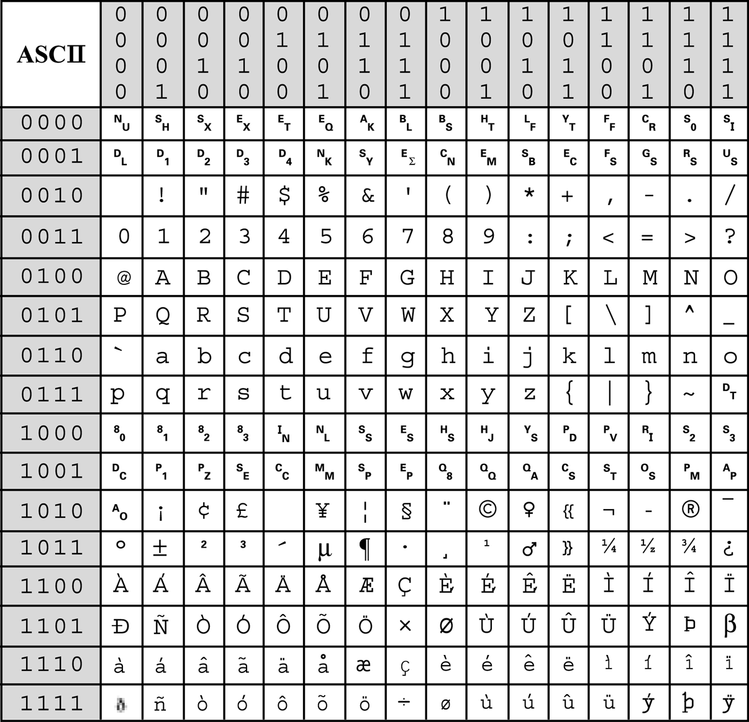
ASCII-8: Table of Characters
0 0 1 1
Character codes | Purpose
0-31 0000 0000 -> 0001 1111 Rows 1 & 2 | ASCII Control Characters The first 32 characters in the ASCII-table are unprintable control codes represent “control” instructions (like chime the system bell, insert new-line, etc) and to control peripherals such as printers.
32-127 0000 0010 -> 0111 1111 Rows 3-8 | ASCII Printable Characters These codes are the “printable characters”, representing letters, digits, punctuation marks, and a few miscellaneous symbols. Char 127 is the “DEL” key.
128 - 256 1000 0000 -> 1111 1111 Rows 9-16 | ASCII “Extended” Characters The last half of the ASCII table stores a variety of miscellaneous control and printable characters. This part of the table is not standardized across all operating systems.
Information above comes from https://www.ascii-code.com/ -- you can find more detailed explanations of the ASCII table there. Note that the “extended” characters are different in this source than my slides -- they are nonstandardized.

Slide 36
ASCII-8
0 0 1 1
Exercise: Decode the following message (left to right, top to bottom)
0100 0001 0101 0011 0100 0011
0100 1001 0100 1001 0010 0000
0110 1001 0111 0011 0010 0000
0110 1100 0110 1001 0110 1101
0110 1001 0111 0100 0110 0101
0110 0100

Slide 37
ASCII-8
0 0 1 1
Hint: Notice that the rows don’t change very much… there are only four possible rows to look at for common letters.
0100: A -> O
0101: P -> Z
0110: a -> o
0111: p -> z
0100 0001 0101 0011 0100 0011
0100 1001 0100 1001 0010 0000
0110 1001 0111 0011 0010 0000
0110 1100 0110 1001 0110 1101
0110 1001 0111 0100 0110 0101
0110 0100

Slide 38
ASCII-8
0 0 1 1
Hint: Notice that the letters are ordered:
0100 0001 -> 0100 0011: A -> C (two apart)
other letters behave as you would expect (q is one after p, 6 is one after 5, etc.)
0100 0001 0101 0011 0100 0011
0100 1001 0100 1001 0010 0000
0110 1001 0111 0011 0010 0000
0110 1100 0110 1001 0110 1101
0110 1001 0111 0100 0110 0101
0110 0100

Slide 39
ASCII-8
0 0 1 1
Exercise: Decode the following message (left to right, top to bottom)
0100 0001 0101 0011 0100 0011
0100 1001 0100 1001 0010 0000
0110 1001 0111 0011 0010 0000
0110 1100 0110 1001 0110 1101
0110 1001 0111 0100 0110 0101
0110 0100
Notes:
The answer is:
A S C I I (space)
i s (space)
l i m i t e d

Slide 40
Unicode
Although ASCII works fine for English and other latin-based languages, many other languages need more than 256 characters. For example:
Chinese characters 汉字
Japanese characters 漢字
Cyrillic Кири́ллица
Gujarati ગુજરાતી
Urdu اردو
You can see that we quickly run into trouble as ASCII can't possibly store these hundreds of thousands of extra characters in just 8 bits.
What we use instead is called unicode. There are several versions of unicode, each with using a different number of bits to store data.
Information above comes from https://en.wikibooks.org/wiki/A-level_Computing/AQA/Paper_2/Fundamentals_of_data_representation/ASCII_and_unicode -- you can find more detailed explanations of the Unicode there there.

Slide 41
Unicode
Name Description
UTF-8 8-bit is the most common unicode format. Characters can take as little as 8-bits, maximizing compatibility with ASCII. But it also allows for variable-width encoding expanding to 16, 24, 32, 40 or 48 bits when dealing with larger sets of characters
UTF-16 16-bit, variable-width encoding, can expand to 32 bits.
UTF-32 32-bit, fixed-width encoding. Each character takes exactly 32-bits
With over 60 thousand characters in UTF-16, and over 4 billion possible characters in UTF-32 we should be able to store every character from every language on the planet. Here are some examples:
code point glyph character UTF-16 code unit (hexadecimal*)
U+007A z LATIN SMALL LETTER Z 007A
U+6C34 水 CJK UNIFIED IDEOGRAPH-6C34 (water) 6C34
*Since the UTF-16 and UTF-32 numbers are very large, it is not convenient to express them in binary. We will learn about hexadecimal numbers next.
Information above comes from https://en.wikibooks.org/wiki/A-level_Computing/AQA/Paper_2/Fundamentals_of_data_representation/ASCII_and_unicode -- you can find more detailed explanations of the Unicode there there.

Slide 42
Hexadecimal Numbers

Slide 43
Hexadecimal Numbers
Why another numeric system?
As we saw with unicode, computers need to be able to read large numbers to tell the difference between many possible characters and/or instructions.
Computers have no problem reading large binary numbers -- but we do! It is annoying to convert 32 bit, or 64 bit, numbers from Binary to Decimal, which makes large binary numbers hard for humans to read and write quickly.
We are fine reading/writing large Decimal numbers, but since 10 is not a power of 2, it does not “fit” evenly with the Binary storage model used by computers.
E.g. with 4 bits we can store 10-16, but need 5 bits to store 17-20 (and beyond).
Consequence: We cannot directly store decimal numbers to machines (transistors) that can only tell the difference between “on” and “off”
What to do?

Slide 44
Hexadecimal Numbers
Introduce a new numeric system! There are infinite possibilities…
Hexadecimal numbers are base 16.
Note: 16 is a power of 2! 2^4 = 16
In other words:
with 4 bits, we can store one “hexit”, values range from 0-1111 (0 -> 15 in decimal)
with 8 bits, we can store exactly two “hexits”, values range from 0 - 1111 1111 (0 -> 255 in decimal)

Slide 45
Building Hexadecimal Numbers
Decimal | Hex (16’s column) | Hex (1’s column)
0 | 0 | 0
1 | 0 | 1
2 | 0 | 2
3 | 0 | 3
4 | 0 | 4
5 | 0 | 5
6 | 0 | 6
7 | 0 | 7
8 | 0 | 8
everything is the same so far...

Slide 46
Building Hexadecimal Numbers
Decimal | Hex (16’s column) | Hex (1’s column)
9 | 0 | 9
10 | 0 | A
11 | 0 | B
12 | 0 | C
13 | 0 | D
14 | 0 | E
15 | 0 | F
16 | 1 | 0
17 | 1 | 1
here is where it gets interesting!

Slide 47
Building Hexadecimal Numbers
Decimal | Hex (16’s column) | Hex (1’s column)
18 | 1 | 2
19 | 1 | 3
20 | 1 | 4
21 | 1 | 5
22 | 1 | 6
23 | 1 | 7
24 | 1 | 8
25 | 1 | 9
26 | 1 | A
etc. etc.

Slide 48
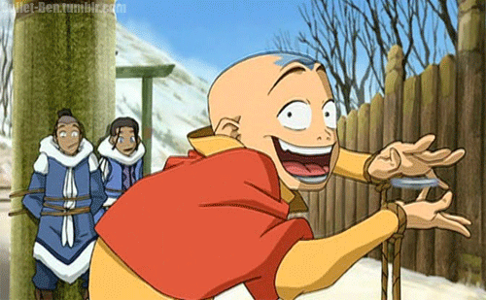
Riddle
Avatar Aang went to get his first driving license. The clerk asked Aang for his ID to make sure he was old enough to do the driving test. The clerk read his ID, and told him that he is not old enough for the test. They him that he needs to be at least 18.
Aang answered, “I’m sorry but you are wrong. I am exactly 18, in decimal. My ID in fact shows my age in Hexadecimal.”
What age is Aang in Hexadecimal (if he is indeed 18 in decimal?)
Decimal 16’s 1’s
18

Slide 49
Why Hexadecimal?
Hexadecimal is perfect for matching 4 bits.
Every combination of 4 bits can be matched with one hex number.
4 bits can be represented by 1 Hex value (“hexit”)
8 bits can be represented by 2 Hex values (“hexit”)

Slide 50
Hexadecimal Digits
Dec Hex Binary
0 0 0000
1 1 0001
2 2 0010
3 3 0011
4 4 0100
5 5 0101
6 6 0110
7 7 0111
Dec Hex Binary
8 8 1000
9 9 1001
10 A 1010
11 B 1011
12 C 1100
13 D 1101
14 E 1110
15 F 1111

Slide 51
What about 8 bits?
Dec. Hex. Binary Dec. Hex. Binary
0 0 0000 8 8 1000
1 1 0001 9 9 1001
2 2 0010 10 A 1010
3 3 0011 11 B 1011
4 4 0100 12 C 1100
5 5 0101 13 D 1101
6 6 0110 14 E 1110
7 7 0111 15 F 1111
-----------------------------------------------------
HEX BINARY
2 4 ?

Slide 52
What about 8 bits?
Dec. Hex. Binary Dec. Hex. Binary
0 0 0000 8 8 1000
1 1 0001 9 9 1001
2 2 0010 10 A 1010
3 3 0011 11 B 1011
4 4 0100 12 C 1100
5 5 0101 13 D 1101
6 6 0110 14 E 1110
7 7 0111 15 F 1111
-----------------------------------------------------
HEX BINARY
2 4 0010 0100

Slide 53
Using Hex for 8 bits
Dec. Hex. Binary Dec. Hex. Binary
0 0 0000 8 8 1000
1 1 0001 9 9 1001
2 2 0010 10 A 1010
3 3 0011 11 B 1011
4 4 0100 12 C 1100
5 5 0101 13 D 1101
6 6 0110 14 E 1110
7 7 0111 15 F 1111
-----------------------------------------------------
Hex Binary Hex Binary Hex Binary
12 0001 0010 3C 0011 1100 99 1001 1001
Exercise: Convert the following 8 bit (1 byte) hexadecimal numbers to binary
AB 1A 00
02 B4 7D

Slide 54
Hexadecimal # RED GREEN BLUE
<td rowspan="2" bgcolor="#cccc99"> </td>
Red Green Blue
cc cc 99
Convert to Binary
Red Green Blue
Hex cc cc 99
Bin 1100 1100 1100 1100 1001 1001
24 bits represent a single color

Slide 55
Q & A
Notes:
In Slide Show mode, click the arrow to enter the PowerPoint Getting Started Center.

